Slide 1
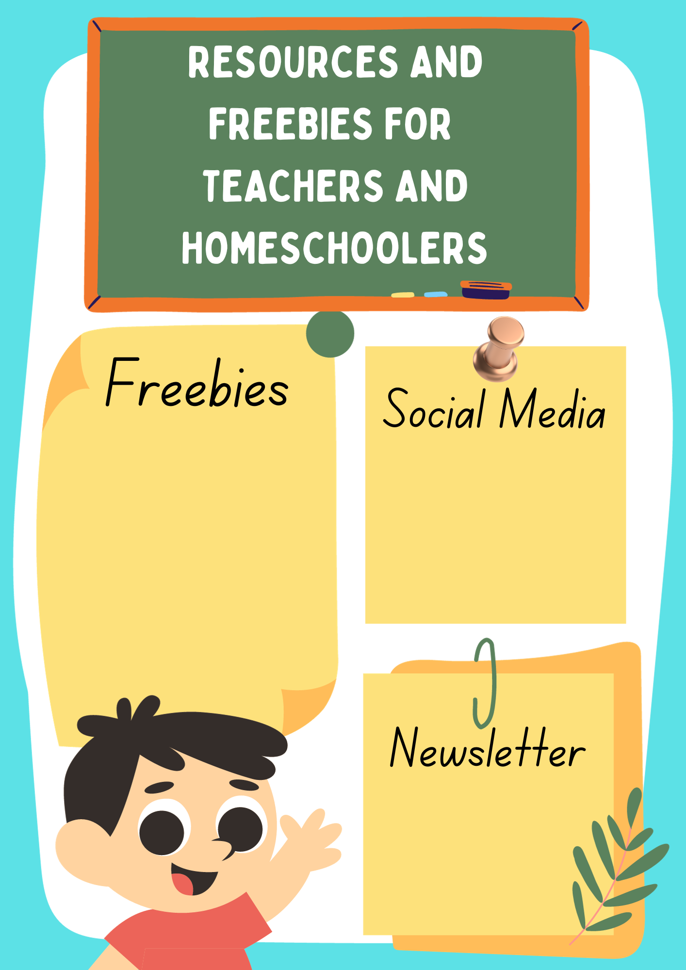
Free Downloads from my TPT Page
Big List of Free Printable Activities by Topic
Autism and Homeschooling Facebook
Positively Autism Facebook
Positively Autism Instagram
Newsletter
Sign-Up

Slide 2
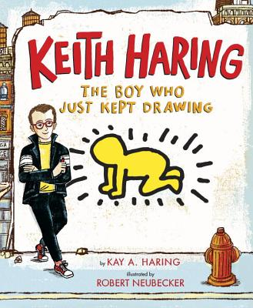
My Favorite Book About Keith Haring

Slide 3
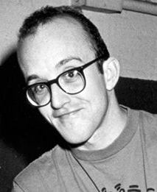
Name: ________________________ Date: ____________________
Read About Keith Haring
Keith Haring Artist: He created colorful artwork with thick lines and fun shapes. Painter: He made large murals on walls and buildings. Creator: He believed art should be for everyone to enjoy.
As a child, Keith Haring loved to draw and make up his own characters. He moved to New York City, where he began drawing with chalk in subway stations. His bright and playful figures quickly became famous. Keith wanted everyone to be able to see and enjoy art - not just in museums. He painted on walls, sidewalks, and even cars! Today, people all over the world still enjoy Keith Haring’s joyful and energetic artwork.
What kind of artist was Keith? Cartoonist Painter Musician Where did Keith start drawing his art in New York? The Subway The Zoo The Library Why did Keith paint in public places? To make people happy. To sell his art.

