Slide 1

What Is Electricity?

Slide 2
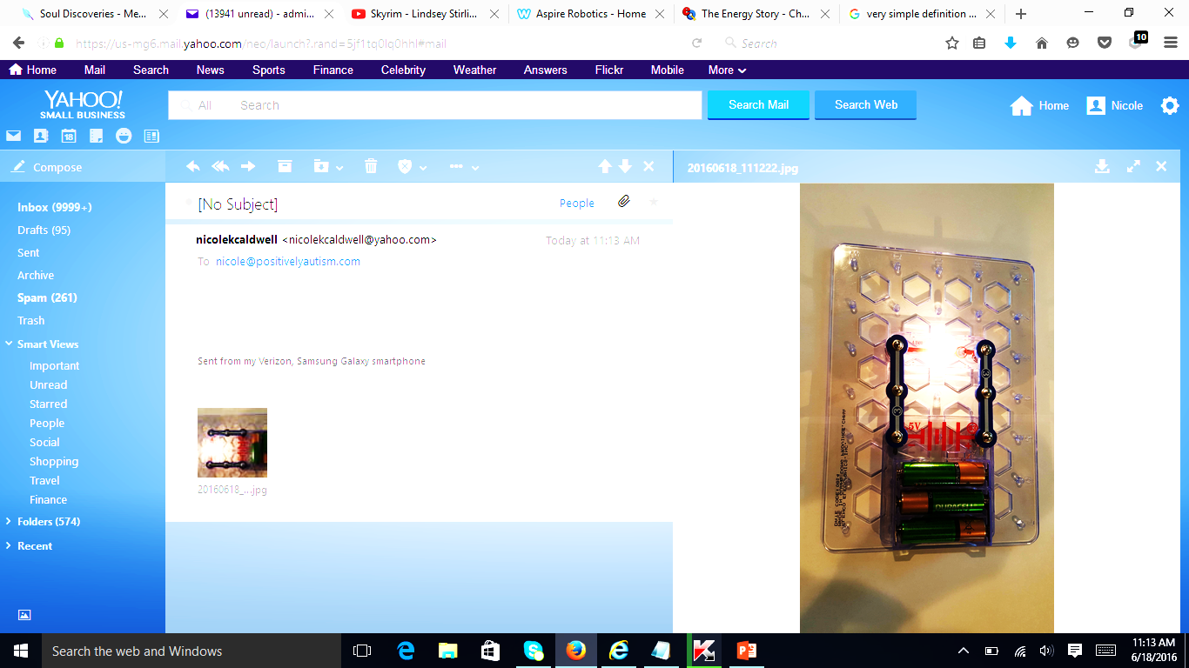
What is Electricity?
Electricity is an energy that is used to give power to many things: lights, TVs, computers, tablets, and more.
Electricity moves around in a circuit.
In this picture, electricity moves from the batteries to a light bulb. This makes the light bulb turn on.
bulb
batteries

Slide 3
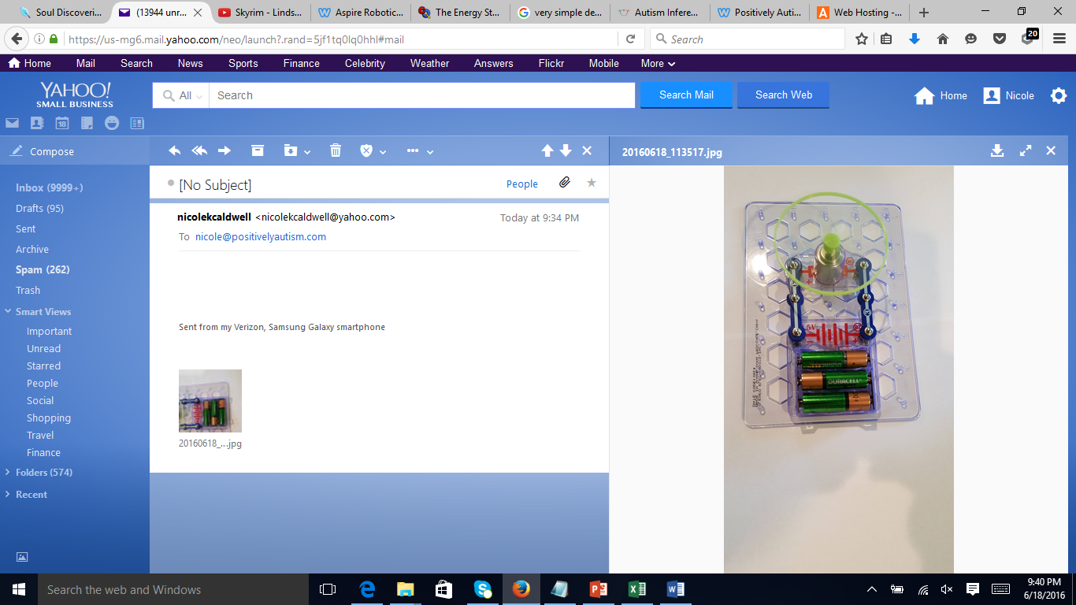
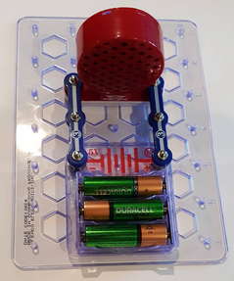
What Can Electricity Do?
Electricity can give power to lots of things. Here are a few examples you can build.
A motor (with a spinner attached).
A speaker. This speaker will not make sound in this arrangement. It’s just to show an example.
A light bulb.

Slide 4
What Is a Circuit?

Slide 5
What is a Circuit?
A circuit is a path or loop that electricity flows around. The arrows show the path the electricity moves from the batteries to the motor.
motor
batteries

Slide 6
We’re going to build some circuits, but first I wanted to tell you about the parts you’ll be using.

Slide 7
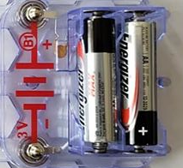
battery holder

Slide 8
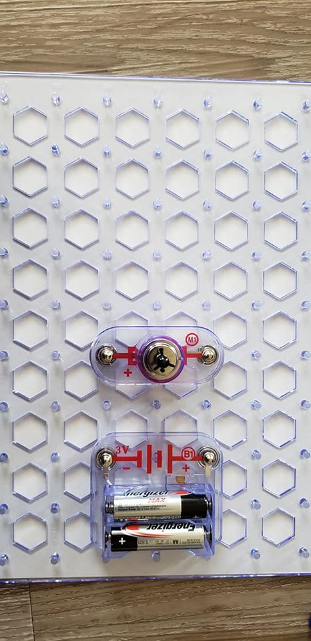
motor

Slide 9
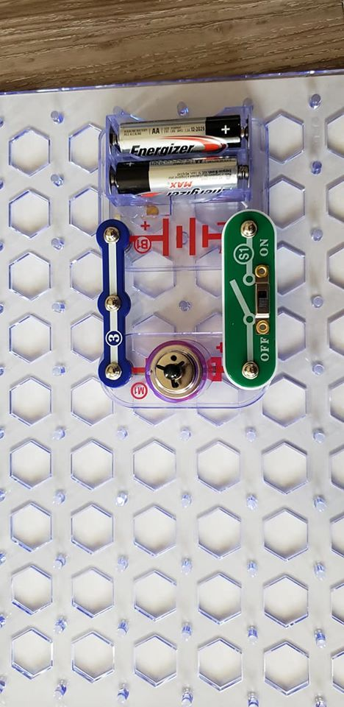
wire

Slide 10
slide switch

Slide 11
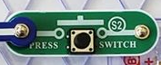
press switch

Slide 12
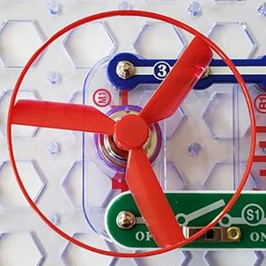
fan

Slide 13
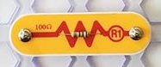
resistor

Slide 14
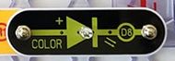
LED

Slide 15
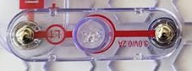
light bulb

Slide 16
Let’s Build Some Circuits

