Slide 1
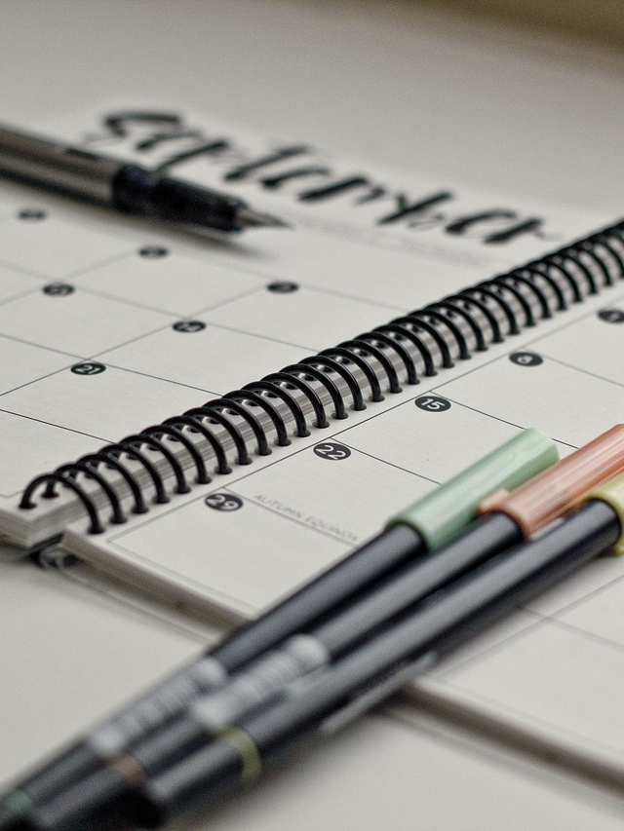
Tutoring Daily Planner
From the Special Education Tutors Facebook Group

Slide 2
Date: ___________________________
Tutoring Sessions
Time | Student | Notes
Meetings
Lesson Planning/Grading
Time | Meeting With: | Topic/Notes
__________________
__________________
__________________
__________________
__________________
__________________
__________________
__________________
__________________
Other:

Slide 3
Date: ___________________________
Tutoring Sessions
Time | Student | Notes
Meetings
Lesson Planning/Grading
Time | Meeting With: | Topic/Notes
__________________
__________________
__________________
__________________
__________________
__________________
__________________
__________________
__________________
Other:

