Slide 1
Help Keep PositivelyAutism.com’s Resources Free!
Amazon.com will donate a percentage of all your purchases to Positively Autism! Start your Amazon shopping at this link for us to get credit.
Shop for fun folder games and schedule charts on our Teachers Pay Teachers.com store.
Take our online training classes on helpful teaching strategies for students with autism. http://www.positivelyautism.com/training/
Thank you!

Slide 2
How to Use
You can either print the pages out, or show them to the student on a computer, Smartphone, or tablet (such as iPad or KindleFire) for vocabulary development. My students seem to enjoy viewing it on a computer, phone, or tablet, but do whatever works best for your child.
Fill out the blanks in the story with information about your own family and read with your child before Thanksgiving to help prepare for the holiday.
This activity is part of a series of activities about Thanksgiving. You can find the rest of these activities here: http://www.PositivelyAutism.com/free/thanksgiving.html

Slide 3
My Family’s Thanksgiving
By: _____________________

Slide 4

Thanksgiving is a holiday in November.

Slide 5
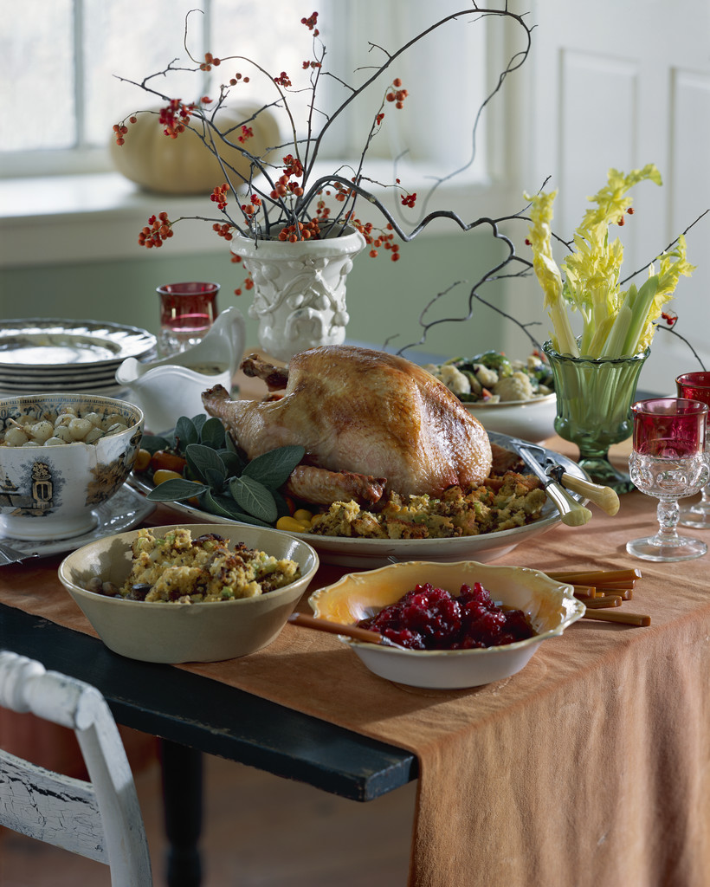
On Thanksgiving, many families eat a large meal together.

Slide 6
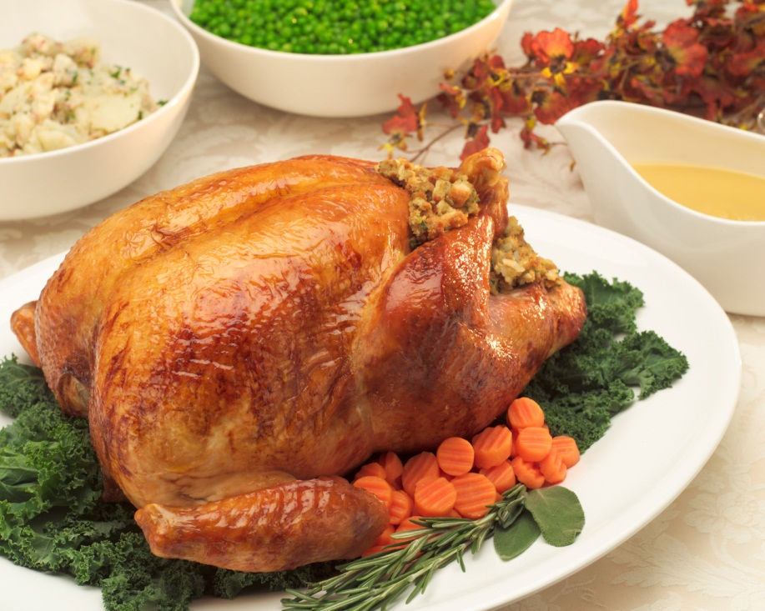
At my family’s Thanksgiving meal, we might eat ______________________
_______________________________
______________________________.

Slide 7
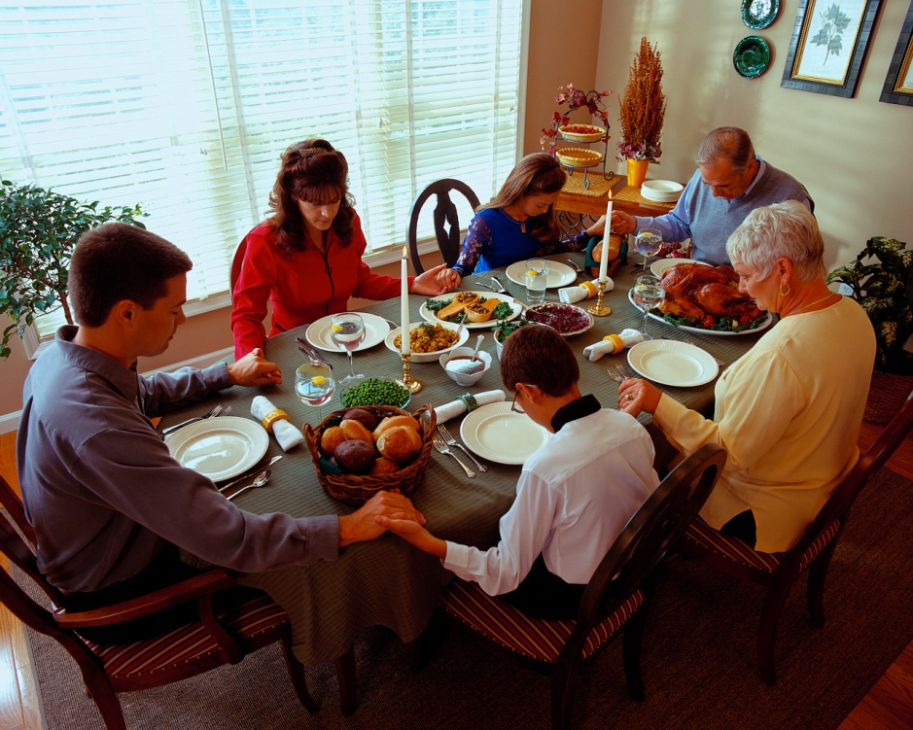
At Thanksgiving, some families say a prayer before they eat. This is sometimes called “saying grace.”

Slide 8
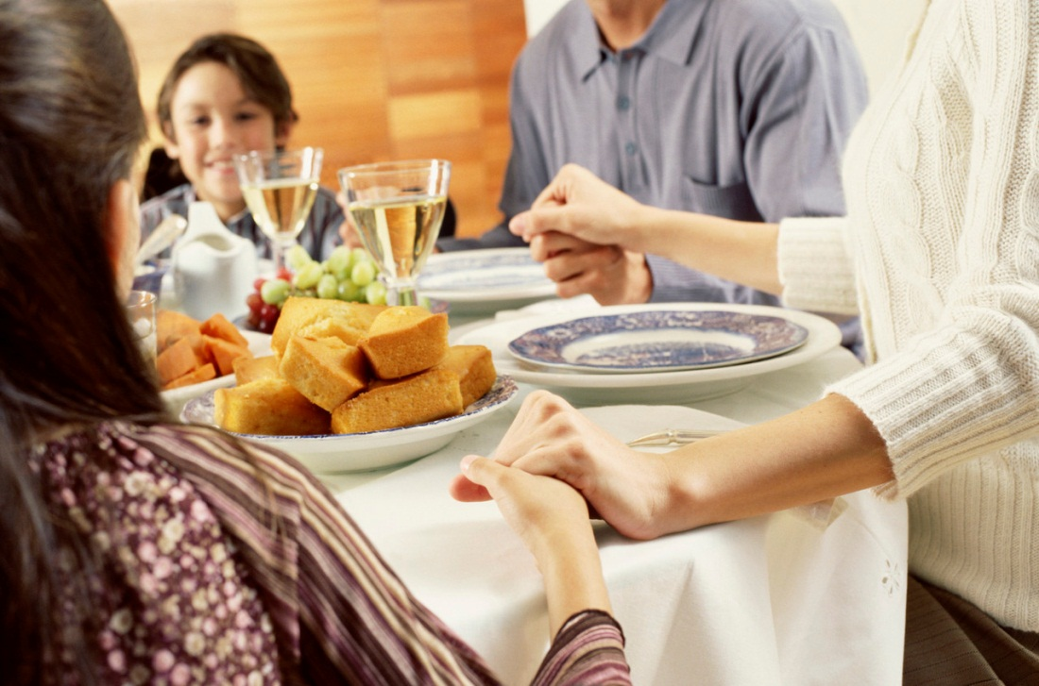
Some families might also tell things they are thankful for. This means they each say something that they like or that makes them happy.

Slide 9
Before we eat, my family will _____
______________________________
______________________________.

Slide 10
After they eat, some families watch football games on TV.

Slide 11
After we eat, my family will _______
______________________________
______________________________.

Slide 12
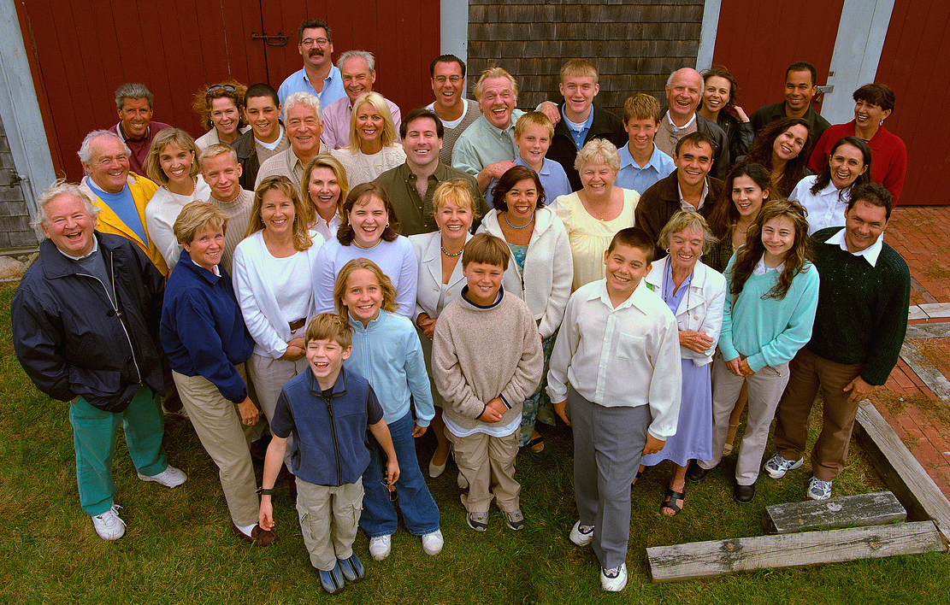
Some families meet with lots of other people in the family for Thanksgiving.

Slide 13
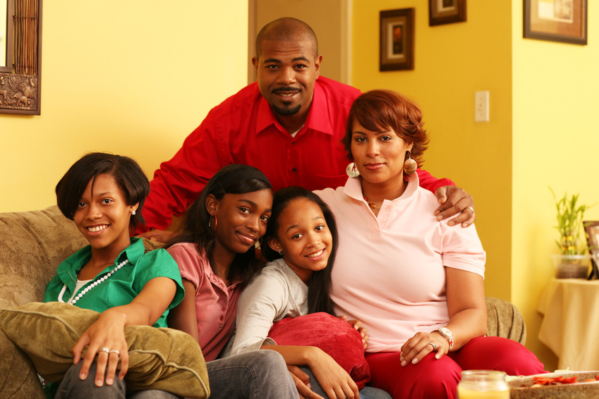
Other families have dinner with just a few people in the family.

Slide 14
My family will ___________________
_______________________________
______________________________.

Slide 15

To visit with family, we might need to travel. Some families travel by car and some travel by airplane.

Slide 16
My family will ___________________
_______________________________
______________________________.

Slide 17

I am learning about Thanksgiving.

