Slide 1
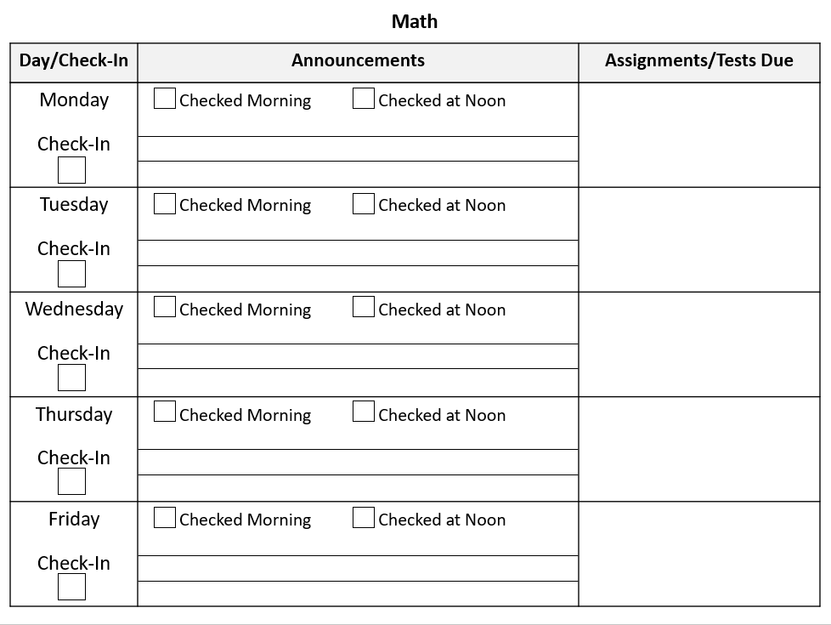
Middle School Structured Daily Planner
For Working on Organizational Skills

Slide 2
How to Use
I’m using this schedule for my son for his virtual school (using Canvas), as I noticed that he was missing things like announcements, daily check-ins, and due dates for assignments.
As a college professor, I’ve used Canvas and it does seem to me that many of the online class systems like this are set-up more for college students, as opposed to a brand-new middle schooler like my son using it for the first time. So, I created this system to help him keep track of his courses.
When first teaching him to use the system, I started by sitting down with him every morning and at noon and filling out the chart along with him for a week (or more if needed). Gradually, I faded this support out and just started checking his chart at lunch and after school. Eventually, I hope to fade this to checking it just after school.
Print one page for each subject each week.
For more resources, please check out Dr. Nicole Caldwell (The Tutoring Fairy) on Facebook:
www.facebook.com/TheTutoringFairy

Slide 3
Subject: _______________________
Day/Check-In | Announcements | Assignments/Tests Due
Monday Check-In | Checked Morning Checked at Noon
Tuesday Check-In | Checked Morning Checked at Noon
Wednesday Check-In | Checked Morning Checked at Noon
Thursday Check-In | Checked Morning Checked at Noon
Friday Check-In | Checked Morning Checked at Noon

