Slide 1


Slide 2
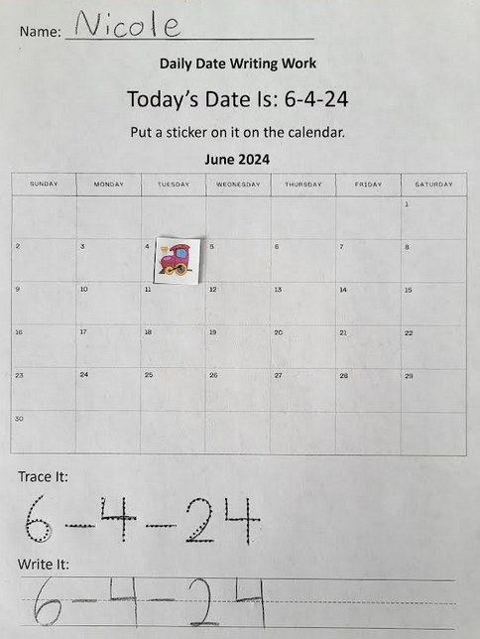
Example

Slide 3
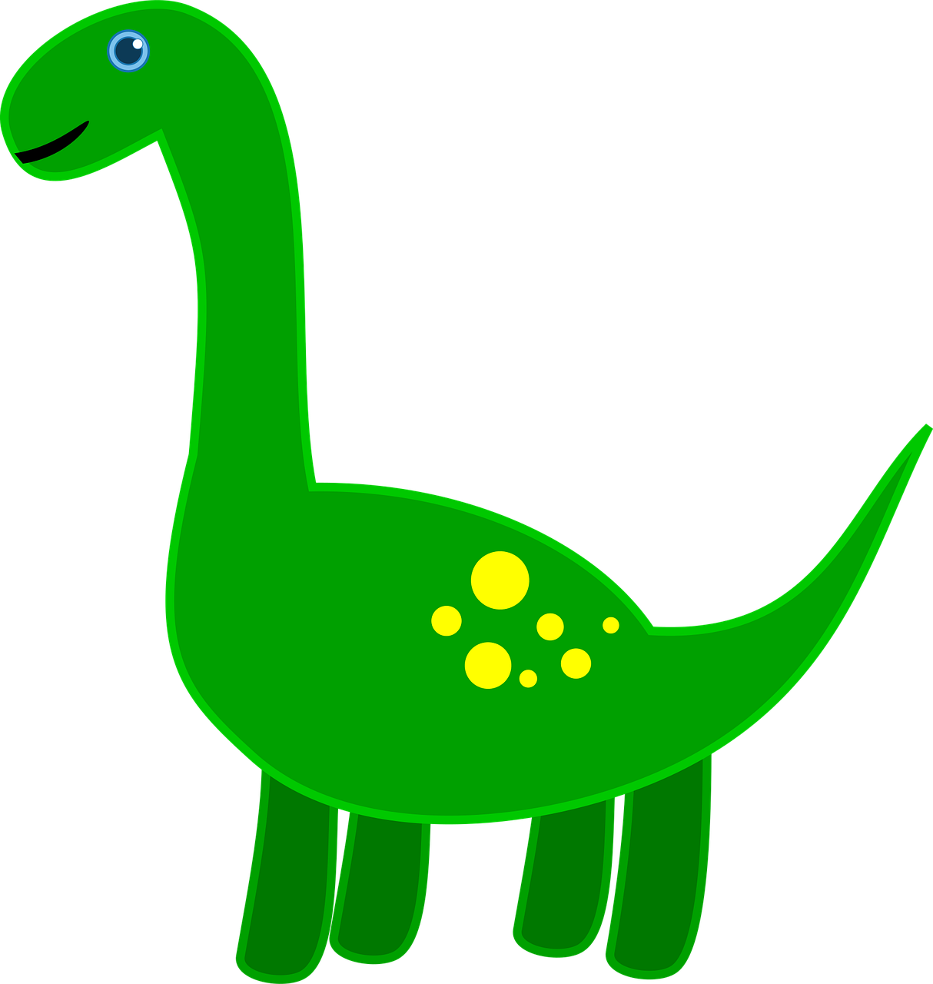

If you don’t have stickers, you can print and cut out these for the student to glue on the calendar.

Slide 4
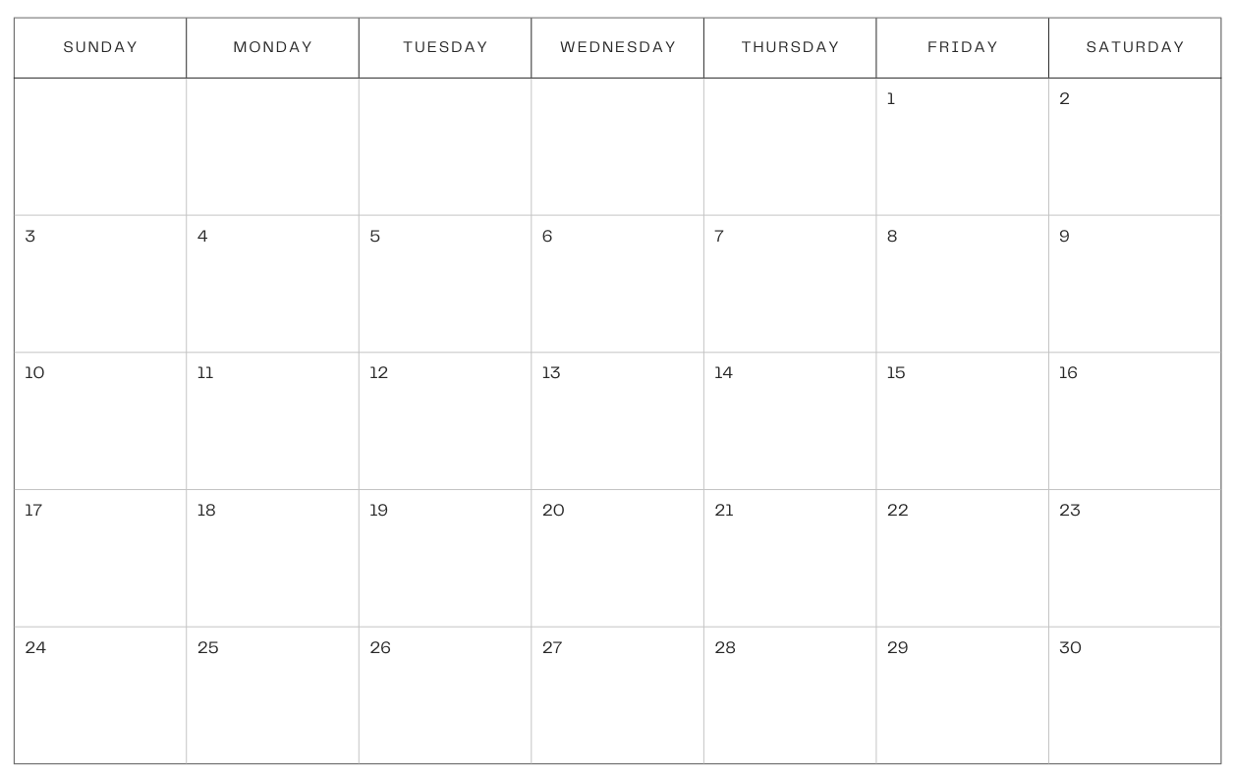

Name: ________________________________
Daily Date Writing Work
Today’s Date Is: 11-1-24
Put a sticker on it on the calendar.
November 2024
Trace It:
Write It:

Slide 5

Name: ________________________________
Daily Date Writing Work
Today’s Date Is: 11-2-24
Put a sticker on it on the calendar.
November 2024
Trace It:
Write It:

Slide 6

Name: ________________________________
Daily Date Writing Work
Today’s Date Is: 11-3-24
Put a sticker on it on the calendar.
November 2024
Trace It:
Write It:

Slide 7

Name: ________________________________
Daily Date Writing Work
Today’s Date Is: 11-4-24
Put a sticker on it on the calendar.
November 2024
Trace It:
Write It:

Slide 8

Name: ________________________________
Daily Date Writing Work
Today’s Date Is: 11-5-24
Put a sticker on it on the calendar.
November 2024
Trace It:
Write It:

Slide 9

Name: ________________________________
Daily Date Writing Work
Today’s Date Is: 11-6-24
Put a sticker on it on the calendar.
November 2024
Trace It:
Write It:

Slide 10

Name: ________________________________
Daily Date Writing Work
Today’s Date Is: 11-7-24
Put a sticker on it on the calendar.
November 2024
Trace It:
Write It:

Slide 11

Name: ________________________________
Daily Date Writing Work
Today’s Date Is: 11-8-24
Put a sticker on it on the calendar.
November 2024
Trace It:
Write It:

Slide 12

Name: ________________________________
Daily Date Writing Work
Today’s Date Is: 11-9-24
Put a sticker on it on the calendar.
November 2024
Trace It:
Write It:

Slide 13

Name: ________________________________
Daily Date Writing Work
Today’s Date Is: 11-10-24
Put a sticker on it on the calendar.
November 2024
Trace It:
Write It:

Slide 14

Name: ________________________________
Daily Date Writing Work
Today’s Date Is: 11-11-24
Put a sticker on it on the calendar.
November 2024
Trace It:
Write It:

Slide 15

Name: ________________________________
Daily Date Writing Work
Today’s Date Is: 11-12-24
Put a sticker on it on the calendar.
November 2024
Trace It:
Write It:

Slide 16

Name: ________________________________
Daily Date Writing Work
Today’s Date Is: 11-13-24
Put a sticker on it on the calendar.
November 2024
Trace It:
Write It:

Slide 17

Name: ________________________________
Daily Date Writing Work
Today’s Date Is: 11-14-24
Put a sticker on it on the calendar.
November 2024
Trace It:
Write It:

Slide 18

Name: ________________________________
Daily Date Writing Work
Today’s Date Is: 11-15-24
Put a sticker on it on the calendar.
November 2024
Trace It:
Write It:

Slide 19

Name: ________________________________
Daily Date Writing Work
Today’s Date Is: 11-16-24
Put a sticker on it on the calendar.
November 2024
Trace It:
Write It:

Slide 20

Name: ________________________________
Daily Date Writing Work
Today’s Date Is: 11-17-24
Put a sticker on it on the calendar.
November 2024
Trace It:
Write It:

Slide 21

Name: ________________________________
Daily Date Writing Work
Today’s Date Is: 11-18-24
Put a sticker on it on the calendar.
November 2024
Trace It:
Write It:

Slide 22

Name: ________________________________
Daily Date Writing Work
Today’s Date Is: 11-19-24
Put a sticker on it on the calendar.
November 2024
Trace It:
Write It:

Slide 23

Name: ________________________________
Daily Date Writing Work
Today’s Date Is: 11-20-24
Put a sticker on it on the calendar.
November 2024
Trace It:
Write It:

Slide 24

Name: ________________________________
Daily Date Writing Work
Today’s Date Is: 11-21-24
Put a sticker on it on the calendar.
November 2024
Trace It:
Write It:

Slide 25

Name: ________________________________
Daily Date Writing Work
Today’s Date Is: 11-22-24
Put a sticker on it on the calendar.
November 2024
Trace It:
Write It:

Slide 26

Name: ________________________________
Daily Date Writing Work
Today’s Date Is: 11-23-24
Put a sticker on it on the calendar.
November 2024
Trace It:
Write It:

Slide 27

Name: ________________________________
Daily Date Writing Work
Today’s Date Is: 11-24-24
Put a sticker on it on the calendar.
November 2024
Trace It:
Write It:

Slide 28

Name: ________________________________
Daily Date Writing Work
Today’s Date Is: 11-25-24
Put a sticker on it on the calendar.
November 2024
Trace It:
Write It:

Slide 29

Name: ________________________________
Daily Date Writing Work
Today’s Date Is: 11-26-24
Put a sticker on it on the calendar.
November 2024
Trace It:
Write It:

Slide 30

Name: ________________________________
Daily Date Writing Work
Today’s Date Is: 11-27-24
Put a sticker on it on the calendar.
November 2024
Trace It:
Write It:

Slide 31

Name: ________________________________
Daily Date Writing Work
Today’s Date Is: 11-28-24
Put a sticker on it on the calendar.
November 2024
Trace It:
Write It:

Slide 32

Name: ________________________________
Daily Date Writing Work
Today’s Date Is: 11-29-24
Put a sticker on it on the calendar.
November 2024
Trace It:
Write It:

Slide 33

Name: ________________________________
Daily Date Writing Work
Today’s Date Is: 11-30-24
Put a sticker on it on the calendar.
November 2024
Trace It:
Write It:

